Slide 1
Fun with Firewalls and Buffer Overflow
Ken Williams
Computer Science department
NC A&T State University

Slide 2
Goal
Teach material about firewall configuration and buffer overflow in an interesting way
Create lab exercises were students enjoy learning about security

Slide 3

Competition
Students enjoy competing
Security topics lend themselves to attack and defend roles
The challenge is create an exercise where offense and defense are equally matched

Slide 4
Firewall Simulation
During the simulation students assume the role of network administrator and are required to configure their firewall to protect their network
Students can also “attack” the simulated networks of other students
During the simulation the security requirements change requiring students to change their firewall’s configuration.

Slide 5
Attacks
Players can initiate an action against another specified player.
If they launch an attack against another player whose firewall is not configured correctly, they earn points while the victim loses points.
Players can initiate benign actions against a player. If the action is inappropriately prohibited, they earn points.

Slide 6
Firewall Configuration
Students configure their firewall using Cisco-like syntax
The configuration syntax was selected so students might also learn something practical about network security

Slide 7
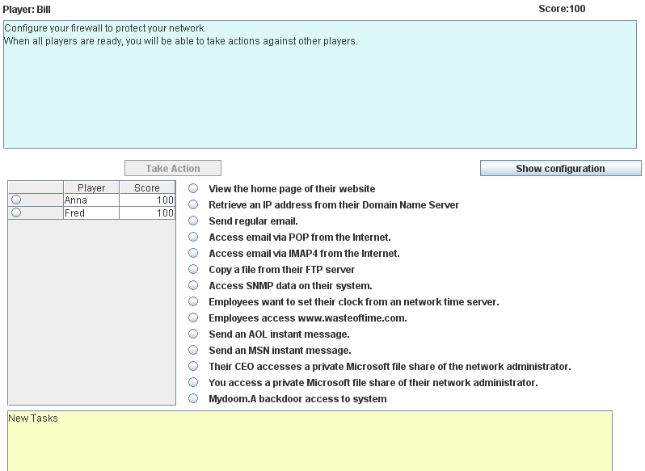
Player GUI

Slide 8
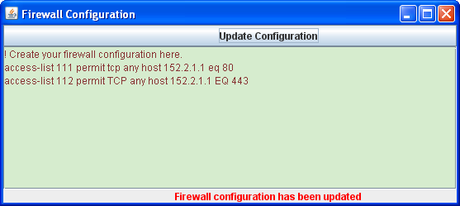
Firewall Configuration Window

Slide 9
The Simulated Network
There is a link on the webpage to a diagram of the simulated network showing the computers and their IP addresses.
Every student’s domain has the Internet address of 152.8.0.0/16
If the destination is 152.8.x.x then the traffic is inbound

Slide 10
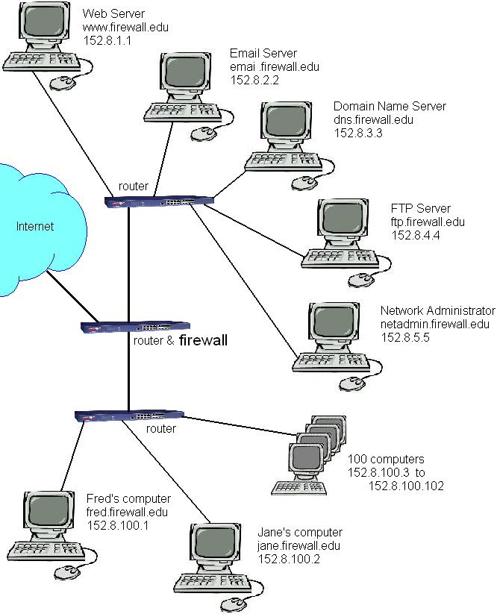

Slide 11
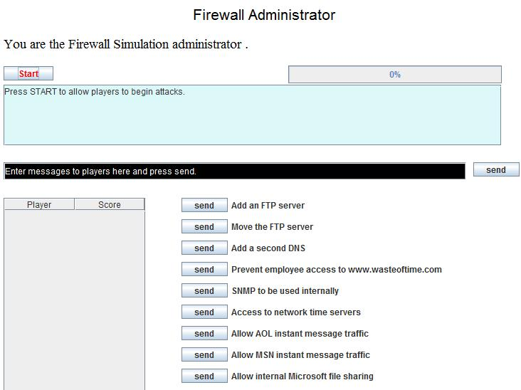
Instructor Control

Slide 12
New Tasks
The instructor can add new configuration requirements
The new configuration requirements also enable actions the students can take against other students
The tasks and actions are read from input files

Slide 13
Fairness
Once a student has successfully attacked another student, they may not initiate the same attack against the same student for 45 seconds
When a configuration change is specified, students have 45 seconds before anyone can be attacked related to that change

Slide 14
Simulator System Requirements
The simulation is designed to run on regular PCs with no special networking restrictions.
Participants need a Java enabled browser.
Runs on Windows, Linux, etc.
Safe to run in a public environment.
The web server has to run the central monitor program.
UDP port 49876 has to be open on real firewalls.

Slide 15
Stack Overflow
We have used an animated demonstration of stack overflow
Students view the animation and then attempt some real buffer overflow attacks
Stack overflow has proven more difficult to make into a competitive event

Slide 16
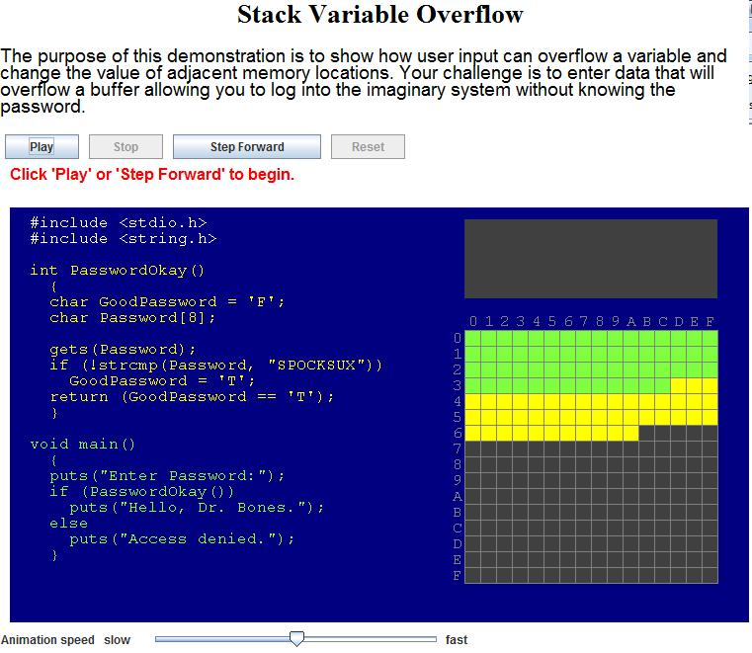
Stack Overflow Animated Example

Slide 17
Case Learning Objectives
Create Cisco firewall rules to satisfy organization policies
Update firewall rules when network architecture is changed
Distinguish the different roles of external firewall and internal firewall

